Slide 1
Predict Term Deposit
Hilman Fadhil Makarim
JCDS Bekasi
2020

Slide 2
Project Description
Deposito berjangka merupakan sebuah produk yang diberikan oleh bank berupa tabungan, dimana uang yang disetorkan dalam deposito berjangka tidak boleh ditarik nasabah dan baru bisa dicairkan sesuai dengan tanggal jatuh temponya.

Slide 3




Goal
Data Cleaning
Data Visualization
Data Optimization
Create web application
Testing
Proyek ini bertujuan membuat sebuah web aplikasi dari local host yang memiliki fungsi yaitu mengklasifikasi kemungkinan seorang customer akan melakukan term deposit atau tidak.

Slide 4
Data Insight
Bank asal Portugis yang melakukan operasi pemasaran penawaran term deposit secara langsung ke customer melalui alat komunikasi, semua data operasi pemasaran terdapat di dataset ini.
Source : Kaggle.com
Total Data : 11162 rows × 17 columns
Target Columnt : deposit
Column :
(age, job, marital, education, default, balance, housing loan, contact, day, month, duration, campaign, pdays, previous, poutcome, deposit)

Slide 5
Data Insight
Age : Umur customer
Job : Tipe pekerjaan customer
Marital : Status pernikahan customer
Education : Pendidikan Customer
Default : Credit card personal apakah default atau tidak
Housing : Apakah customer memiliki kredit rumah
Loan : Apakah customer memiliki personal loan?
Contact : Alat komunikasi yang digunakan dalam campaign
Month : Bulan terakhir customer dihubungi terkait campaign
Duration : Berapa lama customer dihubungi terakhir kali (hitungan detik)
Campaign : Jumlah contact yang dilakukan oleh Bank dengan customer
Pdays : Jumlah hari yang lewat setelah customer dihubungi
Previous : Jumlah contact yang dilakukan oleh Bank sebelum campaign yang sekarang
Poutcome : Hasil dari campaign sebelumnya
Deposito : Apakah customer akhirnya melakukan term deposito atau tidak

Slide 6
Infographic Style
MEMBER
NAME
Get a modern PowerPoint Presentation that is beautifully designed. I hope and I believe that this Template will your Time, Money and Reputation.
You can simply impress your audience and add a unique zing and appeal to your Presentations.
www.hompageurl.com
/FACEBOOK
@TWITTER
You can simply impress your audience and add a unique zing and appeal to your Presentations.
You can simply impress your audience and add a unique zing and appeal to your Presentations.
Example Text Example Text Example Text Example Text Example Text

Slide 7

Infographic Style
Content Here
Content Here
Content Here
Content Here
You can simply impress your audience and add a unique zing.
You can simply impress your audience and add a unique zing.
You can simply impress your audience and add a unique zing.
You can simply impress your audience and add a unique zing.

Slide 8
Infographic Style
80%
You can simply impress your audience and add a unique zing and appeal to your Presentations
70%
You can simply impress your audience and add a unique zing and appeal to your Presentations
Contents Here
Example Text : Get a modern PowerPoint Presentation that is beautifully designed. I hope and I believe that this Template will your Time, Money and Reputation. Easy to change colors, photos and Text. You can simply impress your audience and add a unique zing and appeal to your Presentations. Get a modern PowerPoint Presentation that is beautifully designed. I hope and I believe that this Template will your Time, Money and Reputation.

Slide 9
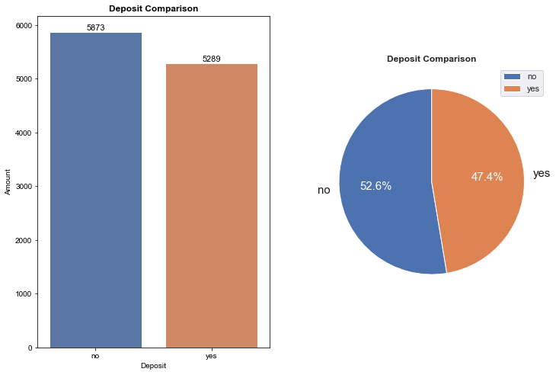
Data Insight
Melihat perbandingan Data Target yaitu Customer yang melakukan Deposito atau tidak.

Slide 10
Machine Learning Model
Logistic Regression
Decision Tree Classifier
Random Forest Classifier
K-Nearest Neighbor
K-Nearest Neighbor

Slide 11
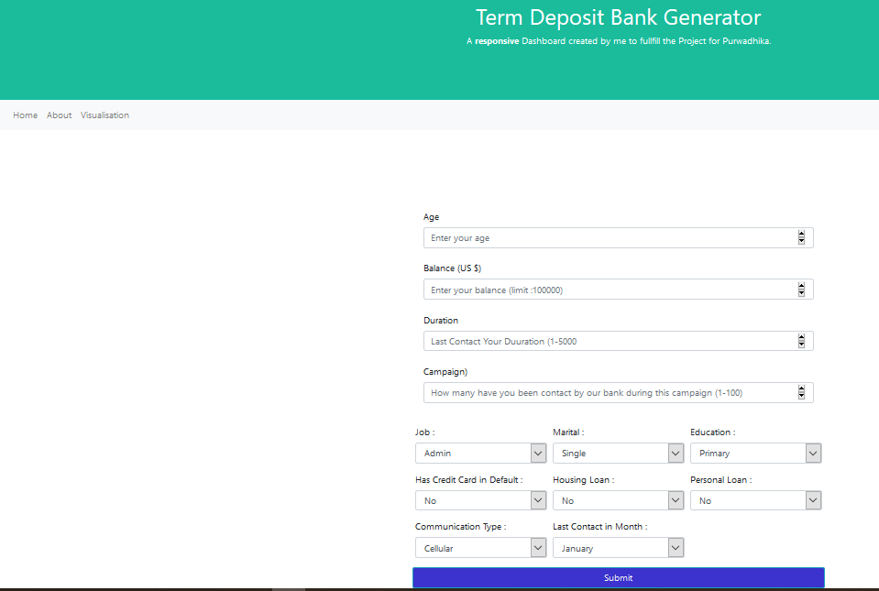
Web App - Home Page

Slide 12
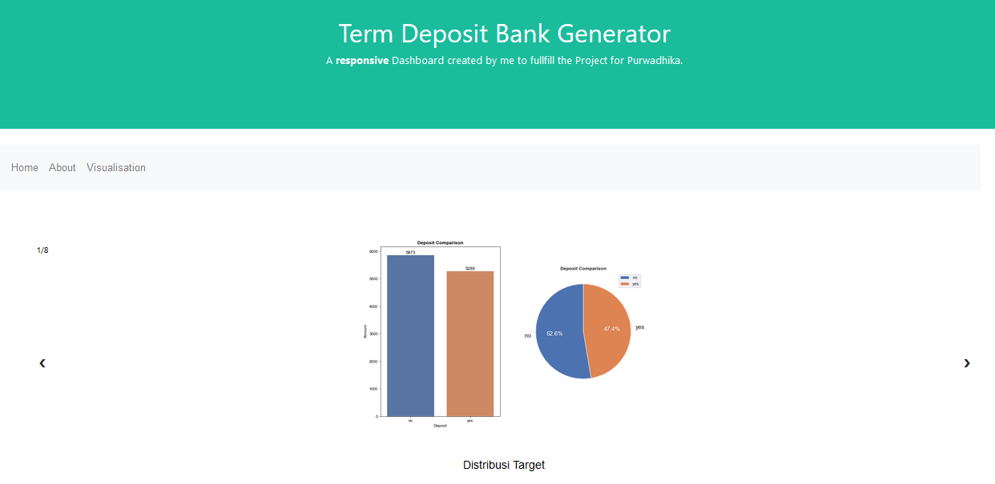
Web App - Data Visualization

Slide 13
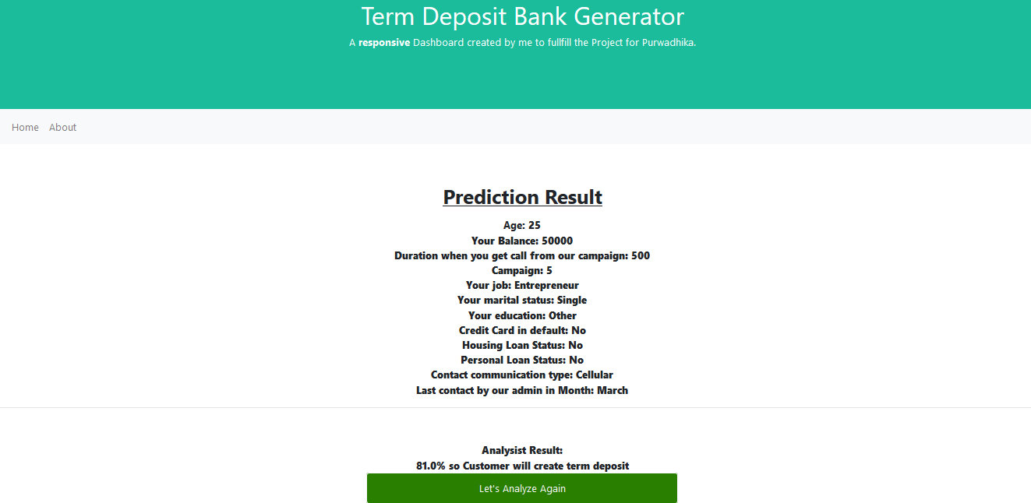
Web App – Good Result

Slide 14

Web App – Bad Result

Slide 15
Thank you

